Slide 1

gendered race, discrimination, & aggression
Peter Gries, Lee Kai Hung Chair and Director, Manchester China Institute, & Professor of Chinese Politics, The University of Manchester
Methods@man UK Crime Data workshop 10 February, 2021

Slide 2


www.mci.manchester.ac.uk

Slide 3
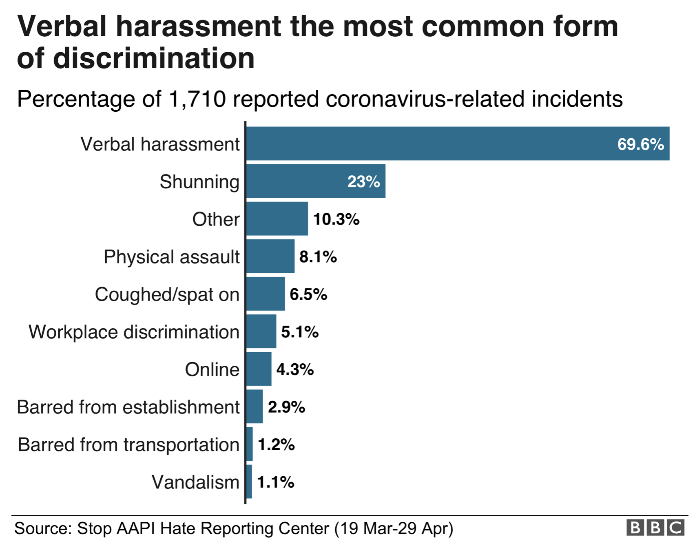
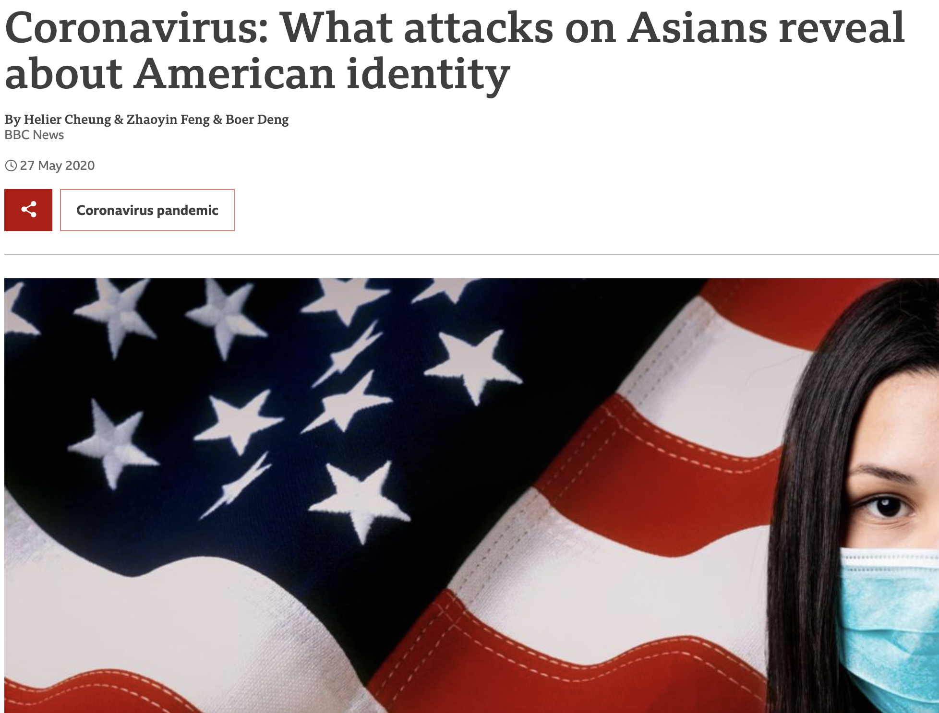

2020 began poorly…

Slide 4
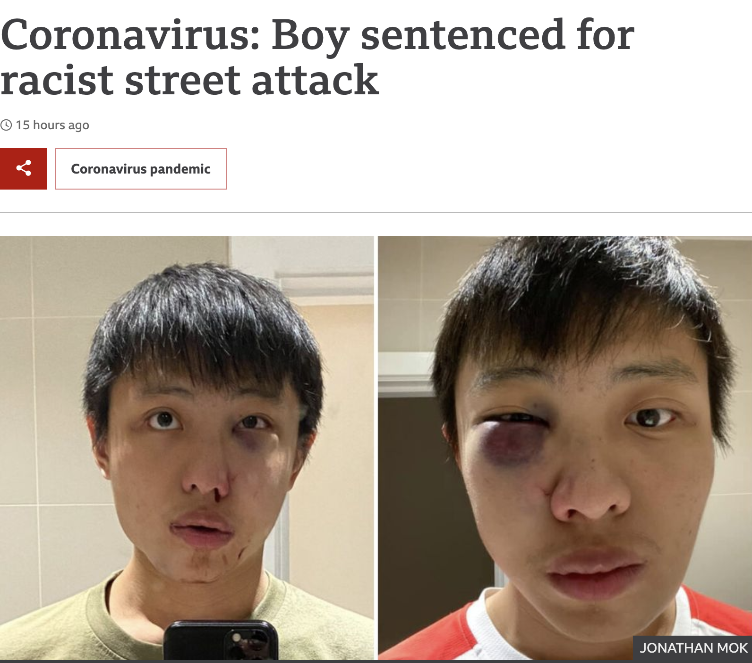
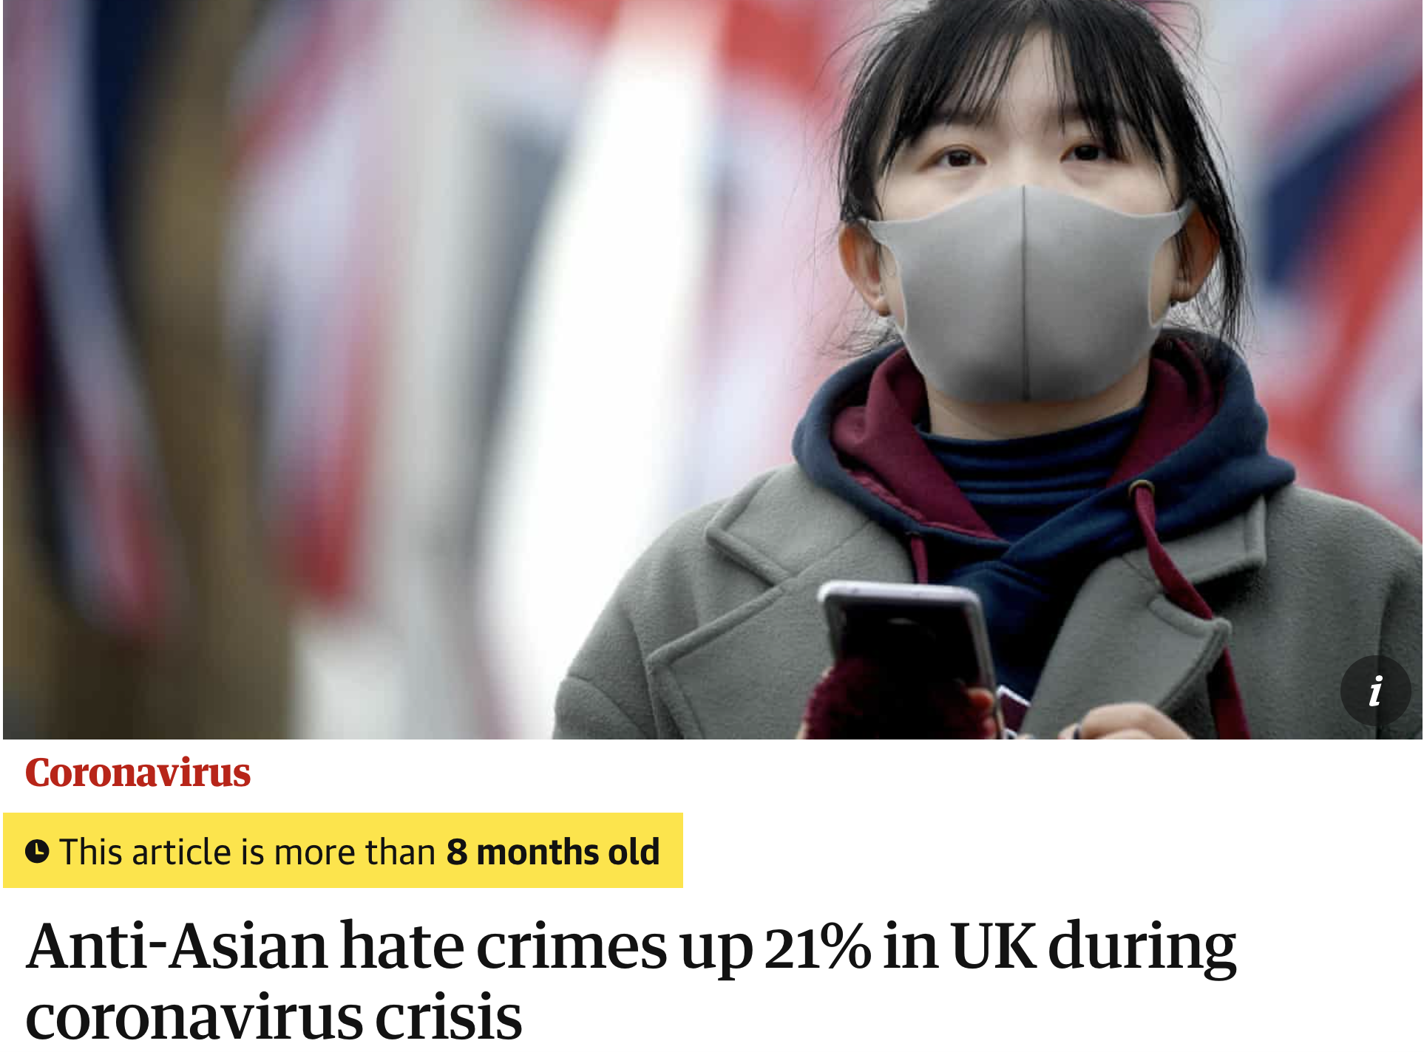
… in the UK too

Slide 5
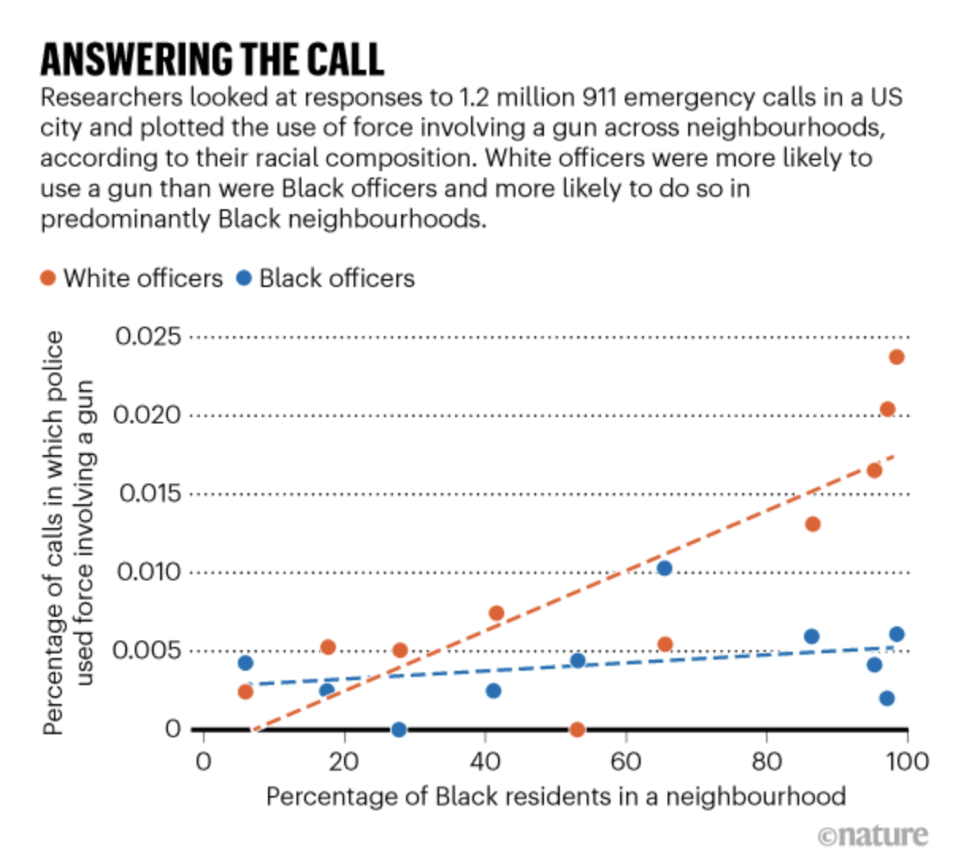
… 2020 gets worse

Slide 6
Initial Q: Do patterns of racial prejudice, discrimination, and aggression differ across races?
Are Asians more likely to be harassed?
Are Blacks more likely to be the victims of disproportionate force?
If so, could such differences be driven by differing racial stereotypes?

Slide 7
Social psychology: Social identity theory (SIT)
… vs ‘them’
Minimal ingroup paradigm’s focus on the borders between ‘us’ & ‘them’
Contents?

Slide 8
Stereotype content model (SCM)
Stereotypes of
Warmth (friendliness, trustworthiness, intentions)
Competence (intelligence, power)
Together shape intergroup emotions and action orientations
BLACKS
ASIANS

Slide 9
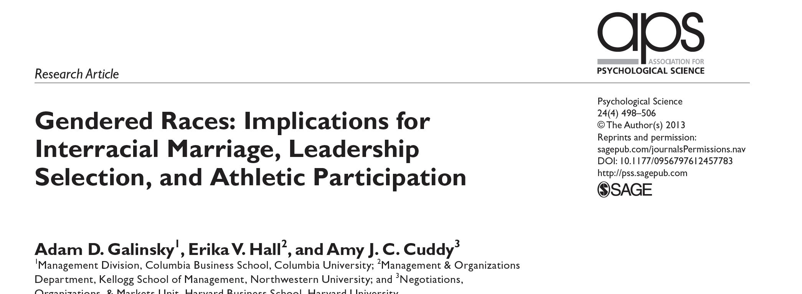
Gendered theory of race
Compared with the White stereotype, the Asian stereotype is more feminine, the Black stereotype more masculine (survey study).
2000 U.S. Census data on interracial marriages:
heterosexual White men had a romantic preference for Asians over Blacks, &
heterosexual White women had a romantic preference for Blacks over Asians

Slide 10
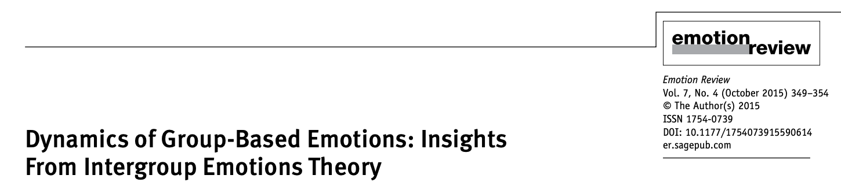
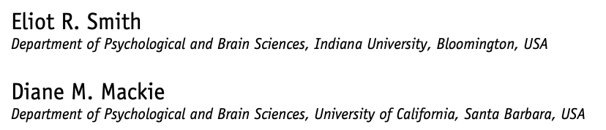
Intergroup emotions and action tendencies
Assessments of relative strength shape emotions and behaviour
relative weakness → avoidance emotions (e.g. fear) → defensive aggression (like overreacting with disproportionate force against Blacks)?
relative strength → approach emotions (e.g. anger) → opportunistic aggression (like harassing Asians)?

Slide 11
Research questions
Do gendered stereotypes about race shape the nature of racial prejudice, discrimination & aggression against Asian & Black men?
Specifically, might emasculating stereotypes about Asian men (as low in physical strength) encourage anger and opportunistic aggression against them?
Might hypermasculine stereotypes about black men (as physically formidable / athletic) inflate fear / perceived threat, increasing defensive aggression, such as disproportionate (e.g. lethal) uses of force?

Slide 12
Research studies (mixed methods)
UK/US crime data: victim race and type of (hate) crime
US Mturk/Qualtrics survey: physical prowess/athleticism stereotypes → intergroup emotions → racial discrimination
Social media study: scraping Twitter or Reddit for “Asians” and “Blacks”→ semiautomated quantitative content analysis.
PAID two month summer internship through UoM Q-Step!!!
Experimental studies

Slide 13
Thank You!

Slide 14
